Slide 1
ECD leadership conference 2026
From compliance to quality

Slide 2
Check in

Slide 3
What are you most proud of in your early learning programme?
Source: DBE
Notes:
This gap has not shifted significantly in the decade I’ve been in the sector and not for lack of trying
SmarStart has certainly made a solid attempt but we are not there yet

Slide 4
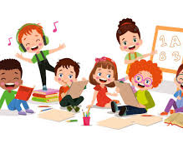

Which classroom is better for 3-5 year olds?
This…
Or that?
Source: Thrive By Five, OMT
Notes:
“Good morning everyone. Today we are talking about something very important:
Not just doing things right… but helping children learn.”
“Let me ask you: If I visited your center, what will I see? What are children doing?
(In your centre, are children quiet and sitting nicely… or are they talking, playing, thinking?”)
Scenario A:
“Children are sitting quietly. They repeat after the teacher: A, B, C. The teacher is happy because children are behaving.”
Scenario B:
“Children are talking, playing with objects, counting, asking questions. The teacher is moving around, asking ‘why?’ and ‘tell me more’.”

Slide 5
Compliance OR quality
Compliance
Quality
Things LOOK right, like we discussed with infrastructure, etc.”
Children are LEARNING.
We want to focus on quality because we want to make sure the children that leave our centres are ready for school.
Notes:
“Good morning everyone. Today we are talking about something very important:
Not just doing things right… but helping children learn.”
“Let me ask you: If I visited your center, what will I see? What are children doing?
(In your centre, are children quiet and sitting nicely… or are they talking, playing, thinking?”)
Scenario A:
“Children are sitting quietly. They repeat after the teacher: A, B, C. The teacher is happy because children are behaving.”
Scenario B:
“Children are talking, playing with objects, counting, asking questions. The teacher is moving around, asking ‘why?’ and ‘tell me more’.”

Slide 6

Is there quality early learning in south Africa?
Only 42% of children are ready to do well in school
Children need more support in ECD, not later at school, otherwise they cannot catch up
Source: Thrive By Five, OMT
Notes:
“Only 42% of children are on track for learning.”
“This means more than half of children are struggling before school
“Some children are even far behind.”

Slide 7
Source: DBE
What do we know about what support children need?
Language
Talking and understanding
Notes:
In South Africa, we now have something called Thrive by Five. It tells us how children are doing before school by assessing children across the country, in early learning programmes
🗣 “Talking and understanding”
🧠 “Thinking and solving problems”
🤝 “Behaviour and getting along”
✋ “Using hands (writing, drawing)”
CEF: Small groups, play, and choice help children learn self-control.

Slide 8
Source: DBE
What do we know about what support children need?
Large muscle movements
Running
Jumping
Balance
Coordination
Notes:
In South Africa, we now have something called Thrive by Five. It tells us how children are doing before school by assessing children across the country, in early learning programmes
🗣 “Talking and understanding”
🧠 “Thinking and solving problems”
🤝 “Behaviour and getting along”
✋ “Using hands (writing, drawing)”
CEF: Small groups, play, and choice help children learn self-control.

Slide 9
Source: DBE
What do we know about what support children need?
Behaviour and self control
Focus
Following instructions
Managing emotions
Notes:
In South Africa, we now have something called Thrive by Five. It tells us how children are doing before school by assessing children across the country, in early learning programmes
🗣 “Talking and understanding”
🧠 “Thinking and solving problems”
🤝 “Behaviour and getting along”
✋ “Using hands (writing, drawing)”
CEF: Small groups, play, and choice help children learn self-control.

Slide 10
Source: DBE
What do we know about what support children need?
Maths skills
Number recognition
Counting
Basic shapes and patterns
Notes:
In South Africa, we now have something called Thrive by Five. It tells us how children are doing before school by assessing children across the country, in early learning programmes
🗣 “Talking and understanding”
🧠 “Thinking and solving problems”
🤝 “Behaviour and getting along”
✋ “Using hands (writing, drawing)”
CEF: Small groups, play, and choice help children learn self-control.

Slide 11
Source: DBE
What do we know about what support children need?
Fine motor skills
Drawing
Cutting
Writing
Notes:
In South Africa, we now have something called Thrive by Five. It tells us how children are doing before school by assessing children across the country, in early learning programmes
🗣 “Talking and understanding”
🧠 “Thinking and solving problems”
🤝 “Behaviour and getting along”
✋ “Using hands (writing, drawing)”
CEF: Small groups, play, and choice help children learn self-control.

Slide 12
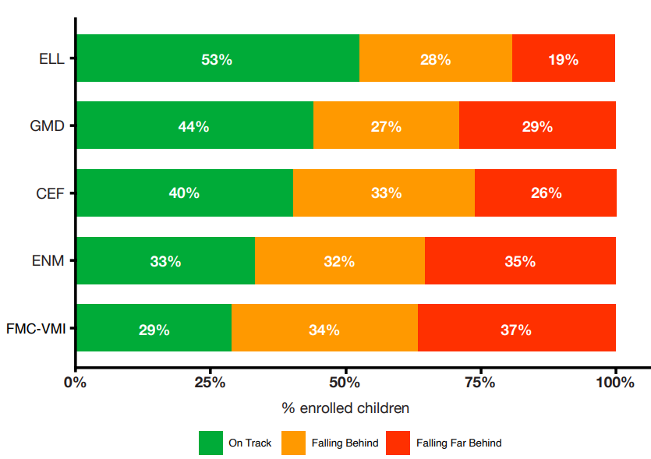
Source: DBE
What do we need to know?
What this means:
Language (talking and understanding)
Large muscle movements (running, jumping, balance, and coordination)
Behaviour and self control (focus, following instructions Managing emotions)
Maths skills (number recognition, counting, basic shapes and patterns
Fine motor skills (drawing, cutting, writing)
Notes:
In South Africa, we now have something called Thrive by Five. It tells us how children are doing before school by assessing children across the country, in early learning programmes
🗣 “Talking and understanding”
🧠 “Thinking and solving problems”
🤝 “Behaviour and getting along”
✋ “Using hands (writing, drawing)”
CEF: Small groups, play, and choice help children learn self-control.

Slide 13
Children are not behind because they cannot learn.
They are behind because they need better quality learning every day
Source: DBE

Slide 14
Which area is most difficult for your children?
Think about how you would manage these challenges
Some children don’t talk
Some cannot count
Some cannot focus
Come can’t draw/ write
    How do children learn language?
    What can you encourage to happen in the classroom?
    What can you use that is easy to find, to encourage this skill
    What type of questions can you ask children in the classroom?
    How do children learn how to be with others?
    What can you do to encourage working with others
    How does choice play a role?
    What happens in the classroom that will encourage children to write?
    What activities can the practitioner do with children?
How can we encourage parents to help their children learn?
    Remember Children learn by: DOING TALKING THINKING PLAYING

Slide 15


What is your commitment?
What is ONE thing you will change tomorrow?
What is ONE thing you will encourage practitioners and parents to do?

Slide 16
THANK YOU

