Slide 1
2026 Shared Bana Pele Blueprint
June 2026

Slide 2




2030 Strategy for ECD programmes
A Shared Vision & Mission
Universal access to quality ECD prioritising the most vulnerable children
Notes:
Recognising the profound impact of ECD, the Department of Basic Education (DBE) has embarked on a strategic reorientation of the Basic Education sector to strengthen foundational learning. The DBE's 2030 Strategy provides the strategic direction to ensure universal access to quality ECD. This strategy sets an audacious goal: to ensure that every child in South Africa has access to quality early learning by 2030.

Slide 3
Expanding Access: Reach an additional 250,000 by 2027, then 950,000 more between 2027 and 2030
Raising Quality:
Increase the Green: From 46% in 2024, to 48% by 2027 and 51% by 2030.
Reduce the Red: From 28% in 2024, to 24% by 2027 and 19% by 2030.
Resourcing the Sector: Mobilise financial and non-financial resources from public, private, philanthropic and corporate partners to support this targeted scale-up.
Enabling Government Systems: Build transparent, responsive and integrated government systems as the backbone of early learning support networks

Slide 4
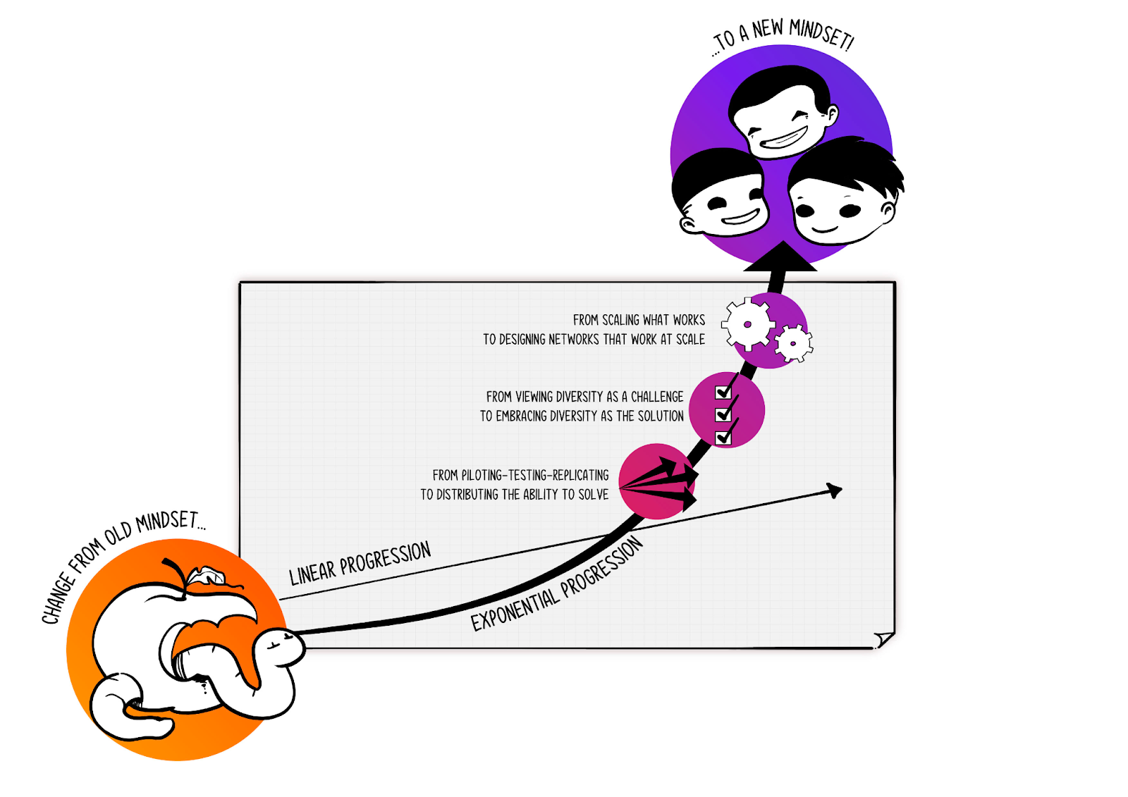
Need exponential change
Ecosystem approach
No single organisation can close the early learning gap alone. A resilient, sustainable system depends on coordinated action across government, civil society, communities and the private sector.
We want to move from building our own beautiful gardens to operating as a flourishing rainforest (ecosystem)

Slide 5
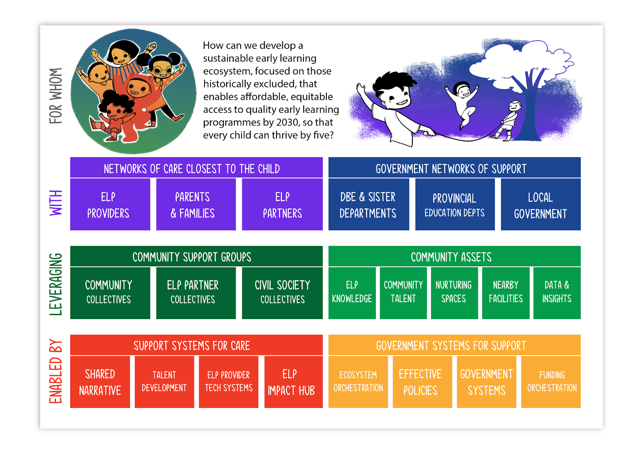
Ecosystem map
ECD Forums
Notes:
In the DBE’s 2030 strategy, it highlighted the need for a social compact, or a ‘whole-of-society’ approach to achieving the vision of universal access to quality ECD programmes. The DBE recently released a shared blueprint as a practical pathway to align and mobilise the entire early learning ecosystem from the government departments represented here today, to communities, ECD providers, families, NGOs, and funders. We represent the national network of support, and have the potential to create an enabling environment for the ecosystem to thrive.

Slide 6
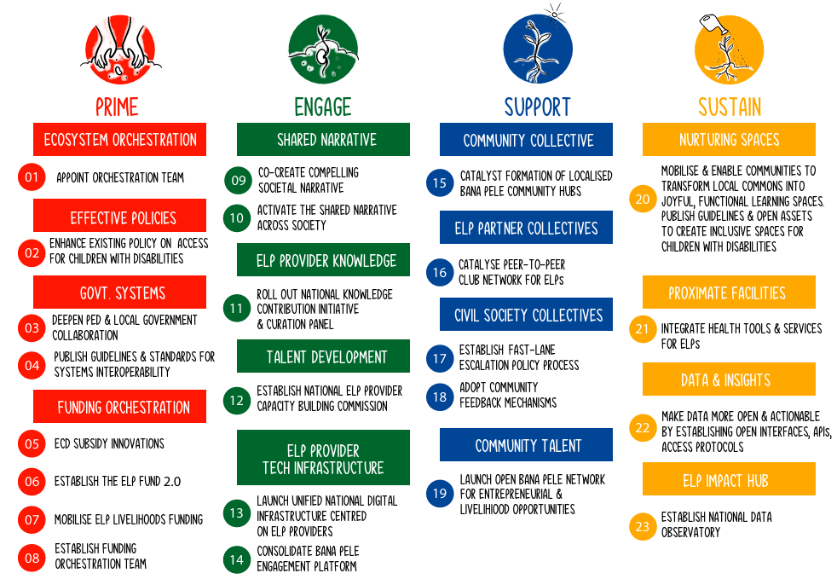
Actions map
Notes:
The joint actions proposed in response to the Thrive by Five Index earlier in this presentation are all included in the Blueprint, along with 19 other actions for the entire ecosystem. We will be tracking our progress on these actions and provide feedback periodically on these actions.

Slide 7
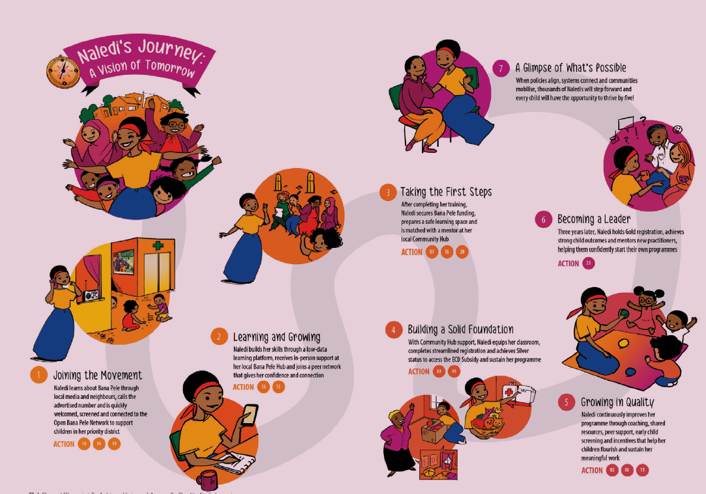
Notes:
The joint actions proposed in response to the Thrive by Five Index earlier in this presentation are all included in the Blueprint, along with 19 other actions for the entire ecosystem. We will be tracking our progress on these actions and provide feedback periodically on these actions.

Slide 8
ECD Forums: Expanding Access to the Most Vulnerable Children
ECD Forums are incredible assets: They are collaborative mechanisms that bring community actors together to support and strengthen early learning centres. These need to be nurtured and feedback from forums is essential for future initiatives.
The power of ECD Forums:
  Peer learning & referral: Successful programmes share what worked — creating confidence through peer examples
  Collective document preparation: Forums pool resources to support ECD programmes to navigate the compliance requirements.
  Local government collaboration: Forums can bring a collective voice to municipal processes and advocate for more developmental approaches by local municipalities.
  ECD Forums sit with incredibly valuable information and knowledge. But most importantly, ECD Forums’ biggest asset is ‘trust’. ECD practitioners trust their Forums for credible, and helpful information. ECD Forums can therefore be strategic enablers in supporting ECD programmes.

Slide 9
Questions for discussion
What examples have you seen of ECD Forums enabling ECD programmes to either register, improve quality, or solve some of the problems that ECD programmes typically face?
How do you think ECD forums can help with expanding access to new ECD programmes?
How do you think ECD forums can help with improving the quality of ECD programmes?
What could help ECD forums to be more effective in playing their unique role?

Slide 10
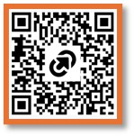
Thank you
Notes:
Break into smaller groups for brainstorming and then present feedback – be creative

